Slide 2
Traffic incidents demand the most

Slide 3
Most response time are within 15 minutes
Roughly 50% of the non-transfer trips are within 15-minute response time
61 % of the non-transfer trips are within 15-minute response time

Slide 4
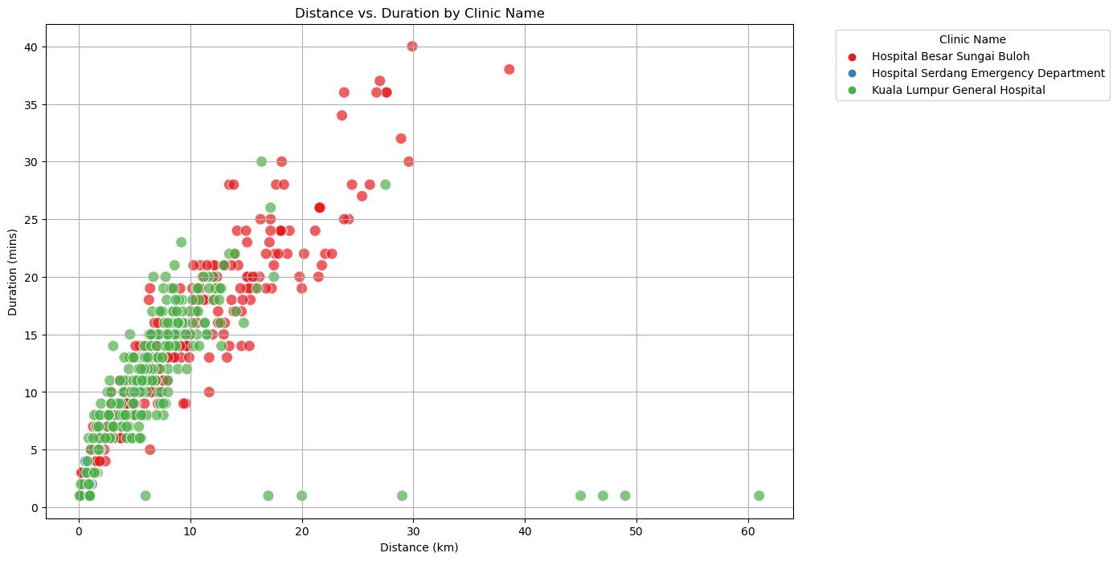
HSB has the widest coverage

